Slide 1


Slide 2
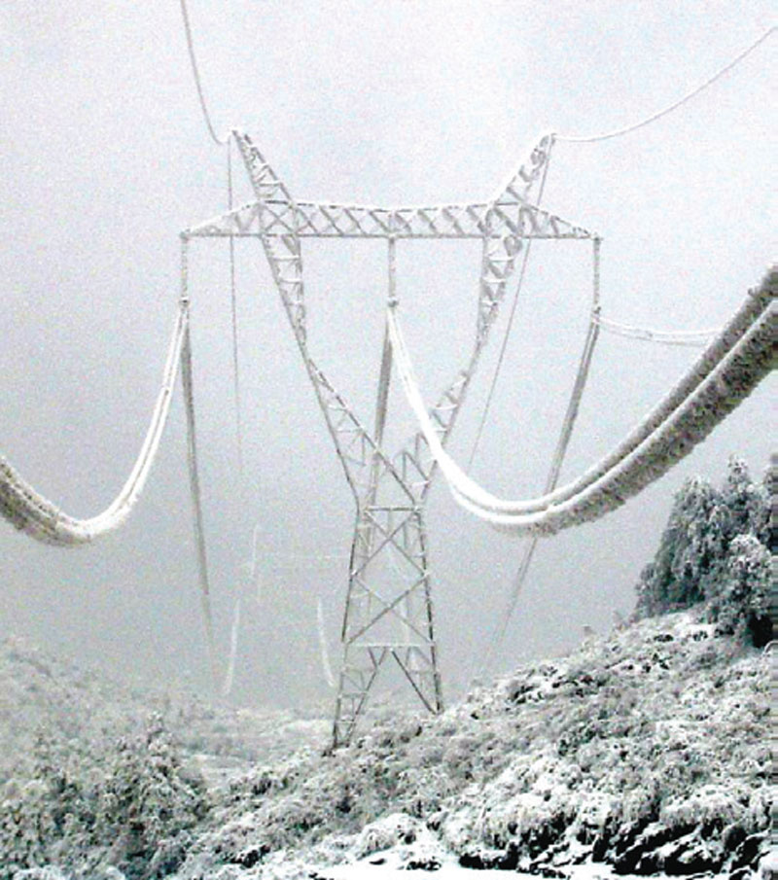
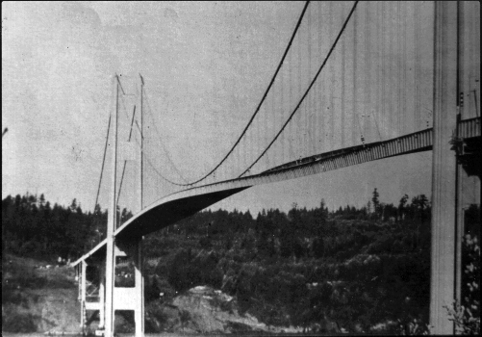
Source :http://en.wikipedia.org/wiki/Tacoma_Narrows_Bridge_(1940)#mediaviewer/File:Image-Tacoma_Narrows_Bridge1.gif
Source: http://www.inmr.com/wp-content/uploads/2013/11/cover.jpg

Slide 19
